Slide 1



Vision Productions
Report on
Hit Ideas Hit Movies
Report By: Smita Gawali
As Part of EDA analysis Project under INSAID Guidance

Slide 2
Problem Statement
Vision Productions, an upcoming film production company has planned a series of movies in the start of year 2017. Among the pipelined movies, we need to decide on the movies that will get us the highest profit and reputation, for our immerging company.
Thus we need to find characteristics of movies, that could earn us maximum Revenue, Rating and Critical acclaim.
We gathered last 10 year’s movies information from, IMDB (Internet Movie Database) which is a popular online database for movies.
IMDB has all details of movies like
Revenue generated on Box Office
Director and Actors worked in the movie.
User voting and ratings from registered users of IMDB.
Metascore from metacritic.com, which involves various critic’s rating

Slide 3
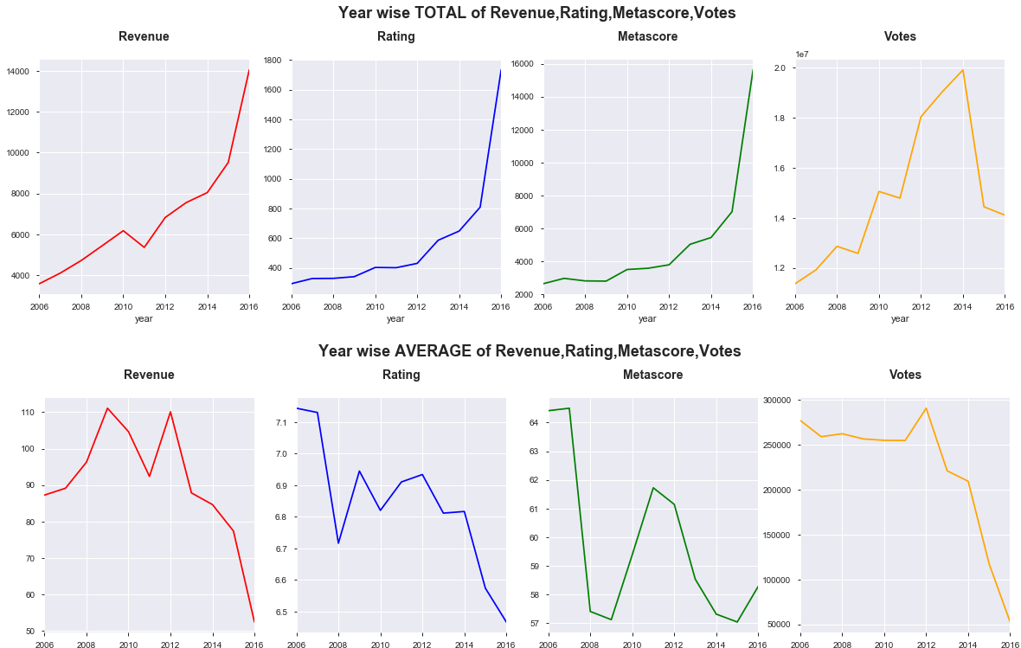
Year wise Trend of Movies
Year by year, upward trend in the total Revenue is seen with significant increase from movies in year 2016.
Total Revenue collected is in correlation with the increase in the number of movies.
There is a decreasing trend seen in the average Revenue, Ratings and Votes. Because with huge number of movies the competition has also increased and revenue and votes got distributed among many movies as per the likeness of the viewers.
Aggregate Metascore, Ratings are seen increased in the year 2016 again due to the increase in the production of movies. Despite big increase in movies released in 2016, the votes received has not increased much.

Slide 4
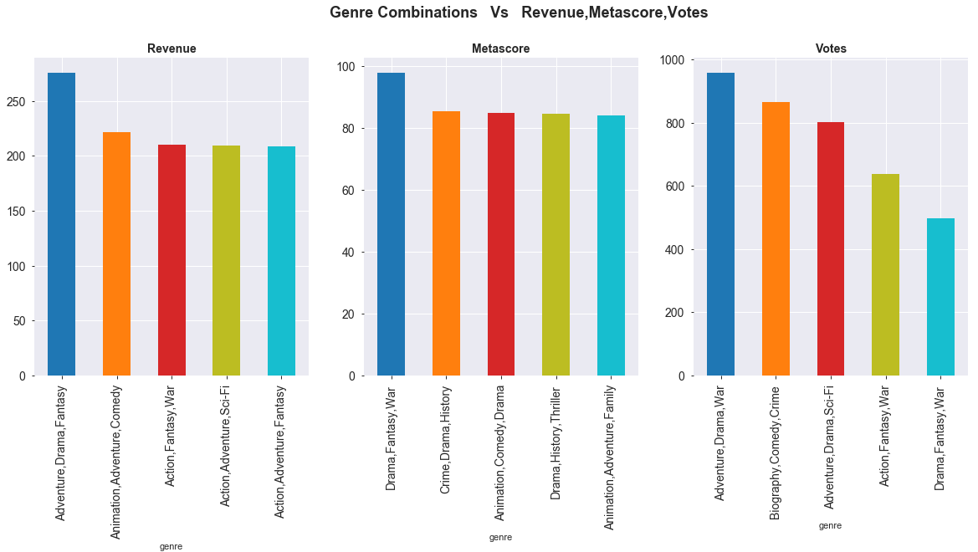
Does Movie's Genre impacts?
It is observed that the Genre combination of "Adventure,Drama,Fantasy" has earned the highest Revenue.
The combination of genre 'Drama,Fantasy,war' has got most Metascore.
The most voted Genre Combination is 'Adventure,Drama,War".
The movies with highest revenue, votes or rating have combination of genre which included Drama as one of the category

Slide 5
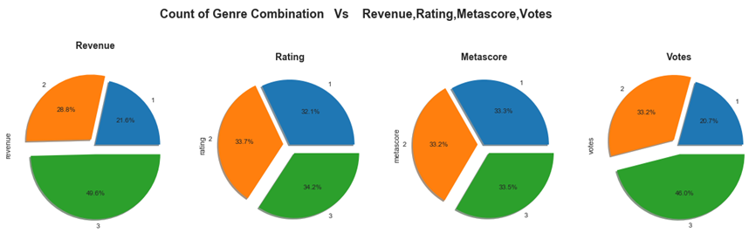
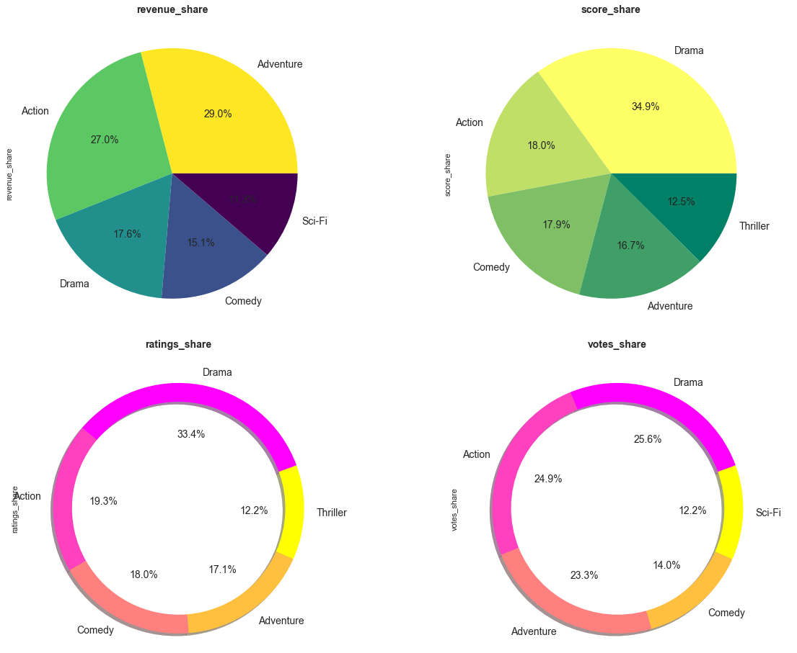
Does Movie's Genre impacts?
Adventure and Action movies are having a good market at the box office.
Followed by Drama, Comedy and Sci-Fi movies.
Number of movies made in Drama genre are maximum.
Also the metascore, votes and ratings received in this Genre is highest.
The movie with 3 Genres tends to earn almost double the revenue than a movie with only one Genre.
The number of Genres in a movie does not much impact Rating and Metascore. But there is a rise in the Votes seen when the Genre count increases.
Genre count is impacting the revenue and votes significantly. As viewer have more tendancy of likeness of movies with multiple taste in the same movie rather than a movie with single category.

Slide 6
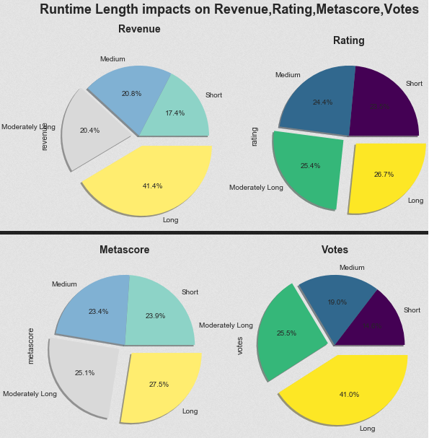
Does Movie's Runtime Length impacts?
Runtime (in Minutes) | Runtime Bin
79-100 | Short
100-111 | Medium
111-123 | Moderatly Long
123-179 | Long
Categorized movie runtime in different runtime levels as above.
It was observed that movies having Long Runtimes gets higher Revenue also they are more popular.
As the Runtime increases there is no impact on Metascore and user Ratings.

Slide 7
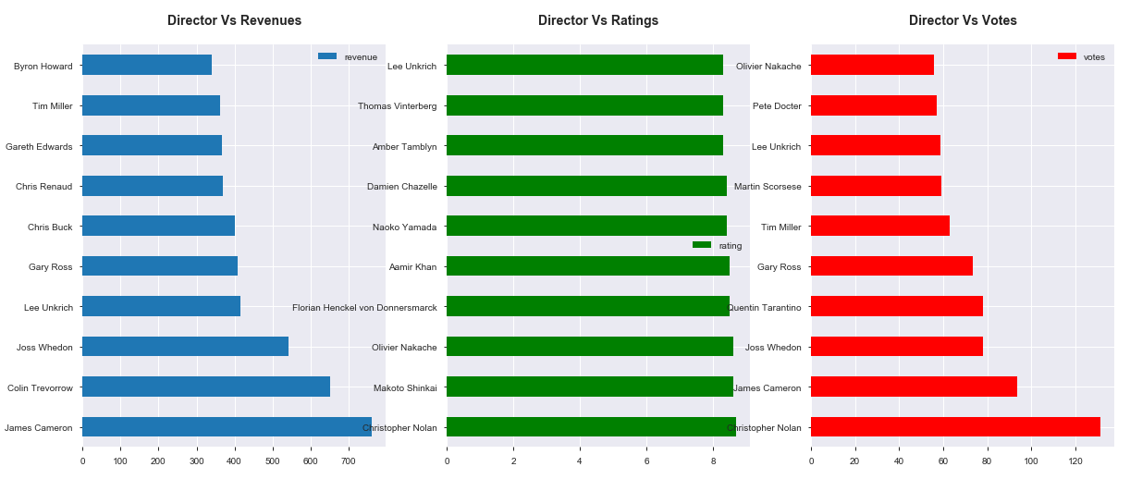
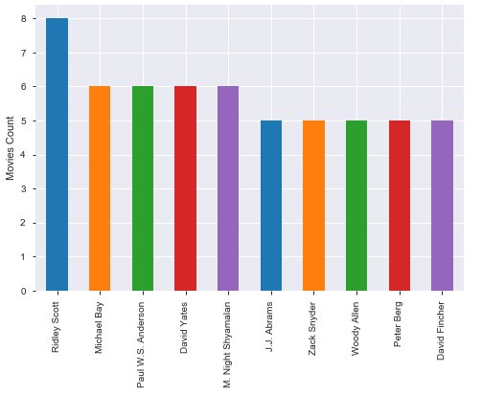
Who were the best directors?
Director with highest movie made in last 10 years is Ridley Scott, so he has good experience.
There is no direct relation b/w directors producing more number of movies vs their revenue earnings.
James Cameron has lead to the highest revenue followed Colin Trevorrow.
User ratings and votes score stand in equilibrium for top rated director with Christopher Nolan being most popular. Followed by James Cameron carrying good votes and popularity among audience.
Revenue collection will need to consider the country in which the movie was released due the currency rates.

Slide 8
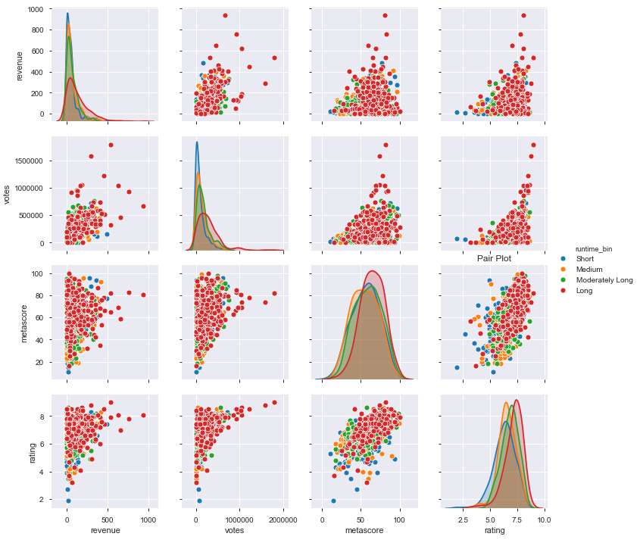
Correlation All Together
Rating and metascore are highly correlated. So it means the users on IMDB and Critics on Metacritic have similar reviews for most of the movies.
It was observed that Revenue Metascore, Votes, all have a positive correlation with Rating. As the Rating increases, the Revenue, Runtime and Votes also increases
Majority of the films that have good rating (>6) have a runtime between 80 - 120 minutes.

Slide 9
INSIGHTS
The number of movies almost doubled from 2015 to 2016.
The movies are spread across 20 different Genres.
Adventure and Action movies are having a good market at the box office followed by Drama, Comedy and Sci-Fi movies.
Highest number of movies was made in the Drama . Also they are rated much higher compared to any other Genres.
Movies taken in Action genre were successful in all the three categories - rating, votes and revenue.
Movies having combination of 3 genres have performed better with good Metascore and larger count of votes as well
Rating and Metascore are highly correlated whereas Revenue and Rating have low correlation
Long Movie Runtimes gets higher Revenue also they are more popular.
High revenue collection movies have high ratings but the vice-versa is not true. That is highly rated or critic acclaimed movies failed to collect money.
The person to direct more number of movies in this period is "Ridley Scott" but the one to understand the pulse of the audience is " Christopher Nolan " and with highest collection taken by “James Cameron”.

Slide 10
CONCLUSIONS!
Though the movies production has increased significantly over the years, the revenue, and ratings has not increased but are in downfall.
Quality of movies rather should be focused more than the count in order to make market credibility and audience confidence
User rating and critic’s score stand in equilibrium for top rated directors. Hence User votes and ratings should be studied thoroughly.
Action, Sci-Fi & Drama have been liked by audience more than any other genre
A combination of 3 genres attracts larger audience thereby create more revenues.
It will be best to pick the combo of successful few genres like , Drama, Action, Adventure, Sci-fi.
Top directors with proven track record should be considered for any successful movie production.
Runtime Duration of movie should be maintained >2 hrs. for better results and audience appeal.

Slide 11
THANK YOU!

